Slide 1
Analyzing crime data via k-means clustering
Sameer Patel
COMP 4449 – Data Science Capstone
Spring Quarter, 2021

Slide 2

Analysis IntenT
Research Question
Project Plan
Can we use clustering methodologies and data science visualization tools to determine whether relationships exist in an unlabeled dataset containing crime statistics for the 50 states in the U.S.
Loading the data
Exploratory data analysis (EDA)
Data preprocessing
Building a machine learning clustering model
Hierarchical Clustering
K-Means Clustering
Evaluation and Visualizations
Conclusion / Further Exploration

Slide 3
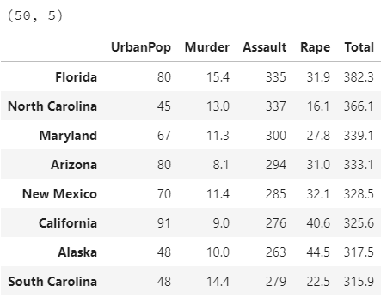
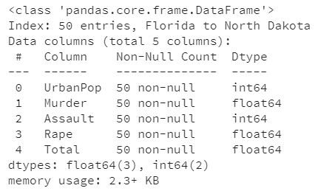
Dataset Source and Description
This data set contains statistics, in arrests per 100,000 residents, for assault, murder, and rape in each of the 50 US states in 1973. Also given is the percentage of the population living in urban areas.
https://stat.ethz.ch/R-manual/R-devel/library/datasets/html/USArrests.html

Slide 4
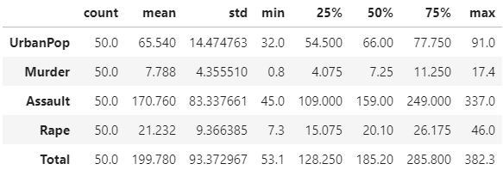
Exploratory Data Analysis (EDA)
Bar Plots
Total crime vs. percent UrbanPop
Crime proportionality
Descriptive statistics
Correlation heatmap
Pair plots
Conclusions
Unequal variances
Slight geographic trend
Surprising: not much correlation of crime with UrbanPop
Features are normally distributed

Slide 5
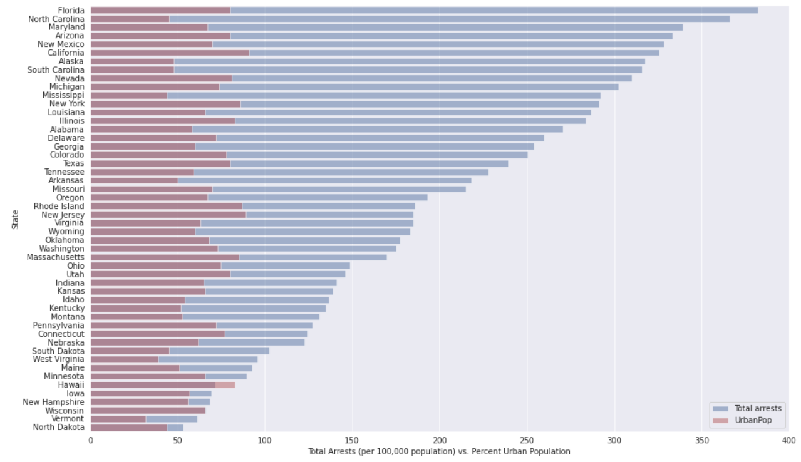
EDA Continued

Slide 6
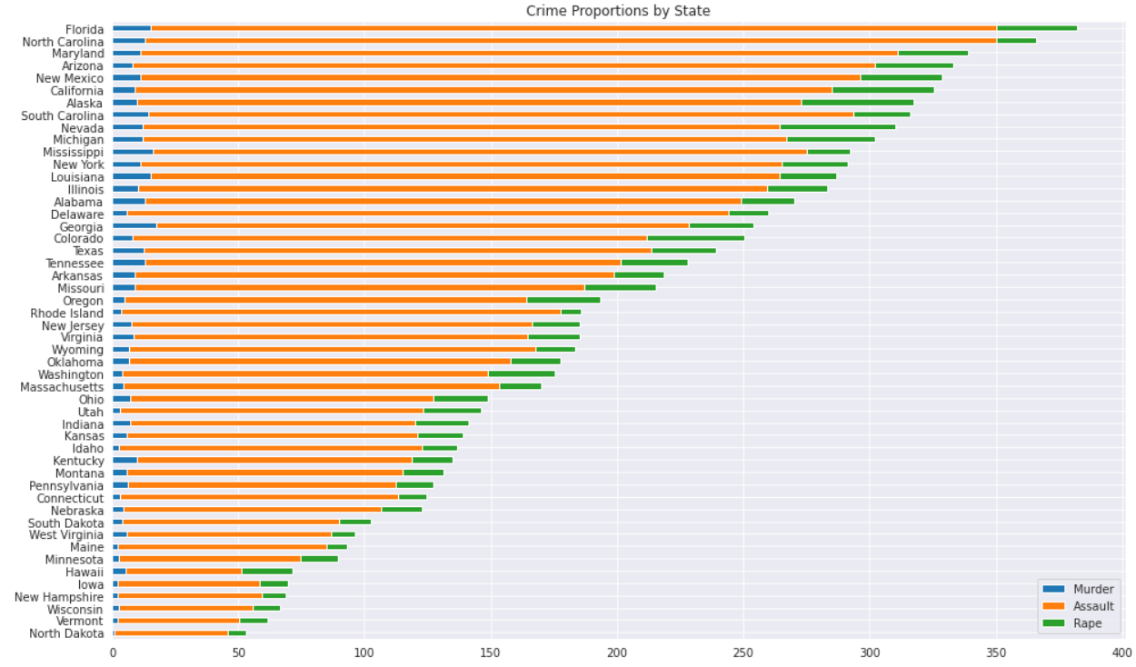
EDA Continued

Slide 7
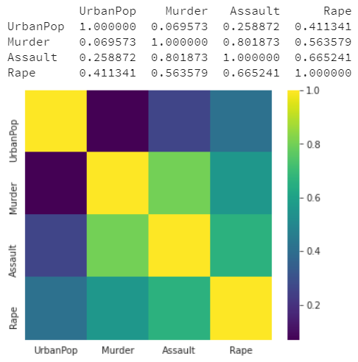
EDA Continued

Slide 8
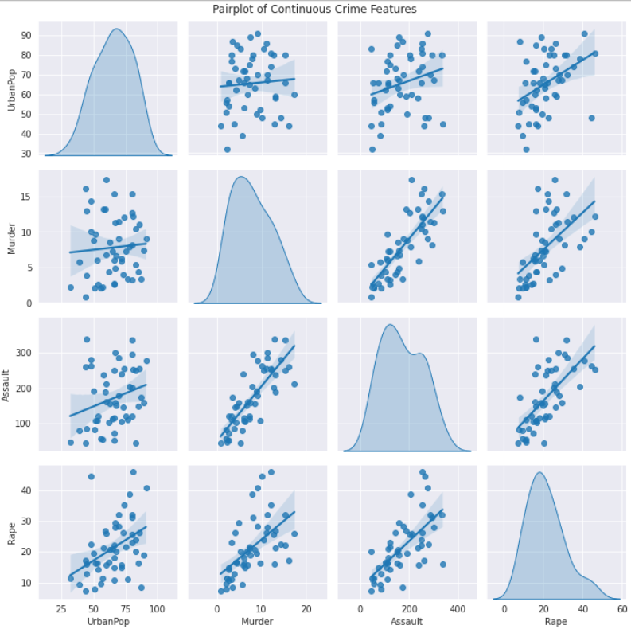
EDA Continued

Slide 9
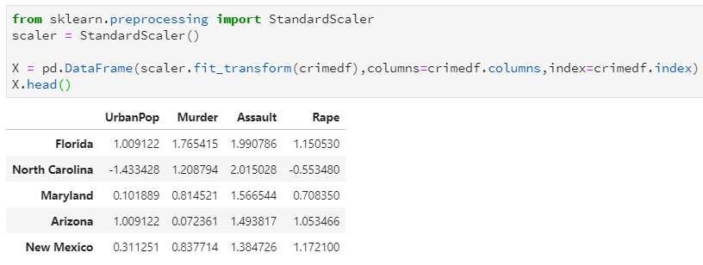
Data Preprocessing
Not much preprocessing is required for this particular dataset
Clustering typically requires scaling prior to model fitting
Feature scales could vary and could therefore have imbalanced influences on the resulting clusters based on the distance metric used
Use preprocessing library in sklearn, specifically StandardScaler()

Slide 10
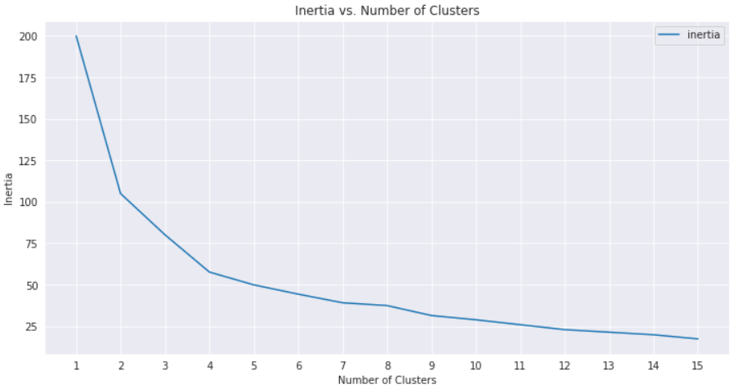
Model Building
Scree Plot

Slide 11
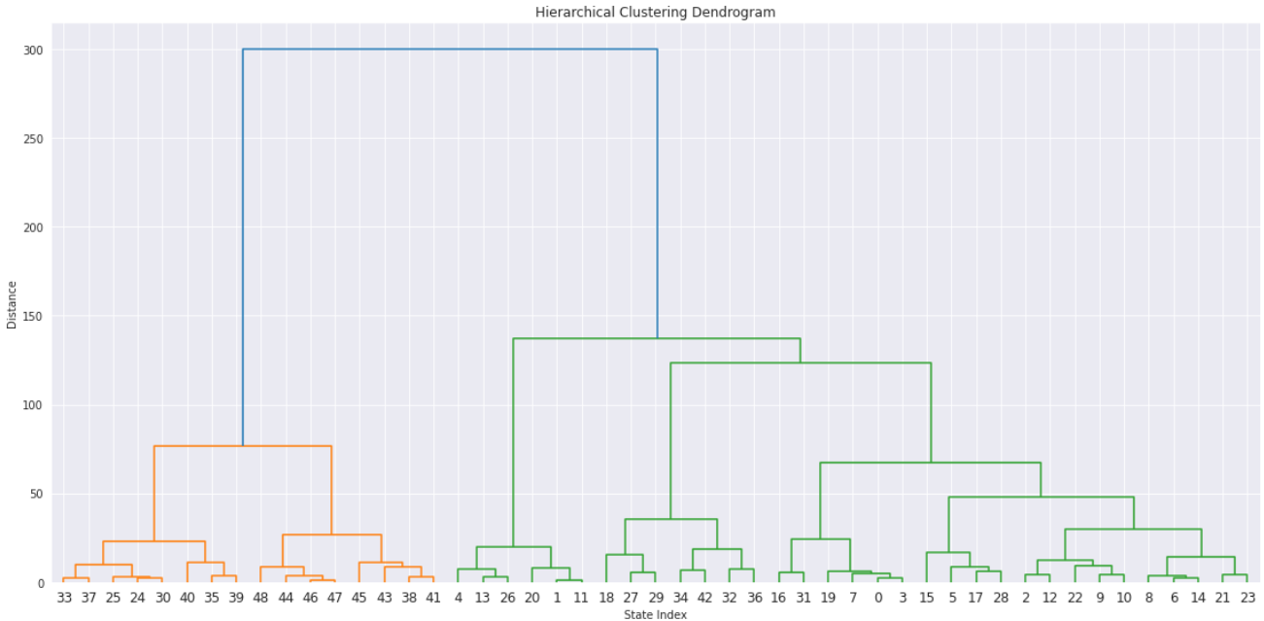
Model Building
Dendrogram

Slide 12
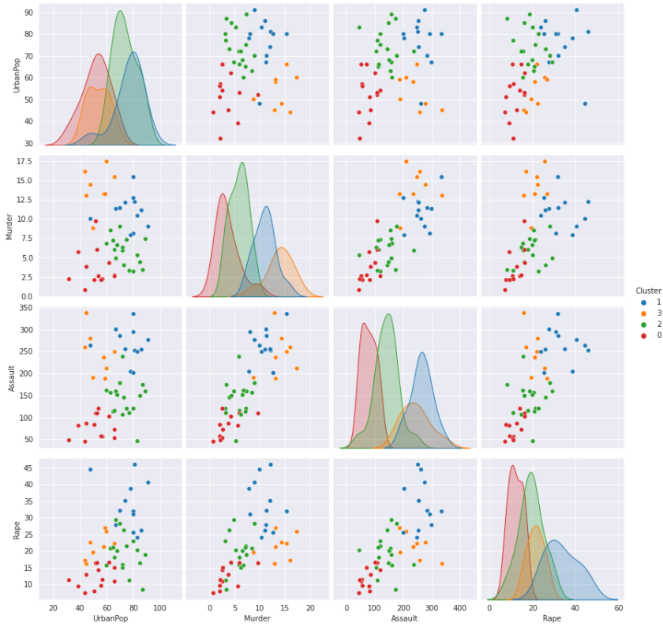
Model Evaluation / Visualizations

Slide 13
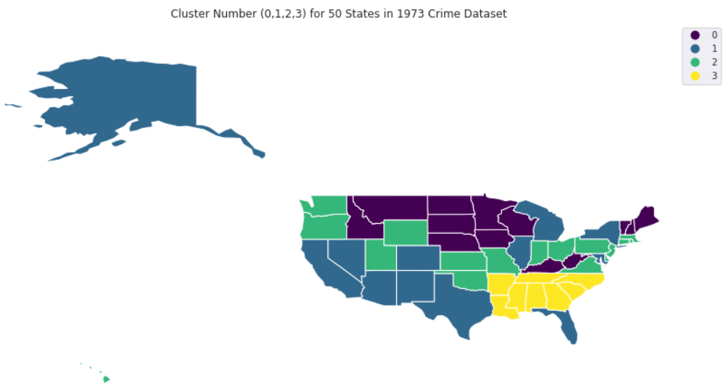
Model Evaluation / Visualizations

Slide 14
Conclusion / Future analyses
Surprisingly, a very clear geographic relationship exists amongst the clusters.
Cluster 3, which tended to have higher crime numbers across the board, is neatly localized in the Deep South.
Cluster 1 also had relatively high crime numbers, which could explain the grouping of high-population states within it (eg. Texas, Florida, California, New York, Illinois).
More rural states were grouped into Clusters 0 and 2, with Cluster 0 tending to be further North than Cluster 2.
Supplementary datasets could be added to the model
Total population in 1973
Metrics such as happiness index or state-wide GDP.
PCA to reduce the number of input features while preserving the variance
Better cluster visualization depending on the number of returned components.

